Slide 1
FBLA CSA Tracker
Nathaly Jose-Maria
Alpharetta High School
Notes:
Introduce github?
Put references and approvals in github or presentation? Needed?
JavaTPoint: https://www.javatpoint.com/java-swing
GeeksforGeeks
StackOverflow

Slide 2
Research
What is going into the project?

Slide 3



Technological Decisions
Google Web Toolkit
Java SE11 FX
Archaic Java AWT
Eclipse Standard Widget Toolkit
Java SE8 Swing
Text File
Local Database
Windows
Look-and-Feel
Advisor
User-Interaction
Notes:
Archaic – not enough features
FX – too many features
Web Toolkit – wanted non-HTML application
Eclipse – great since part of my working environment but confused with how to integrate cause I wasn’t all that familiar with Eclipse quite yet; also worried wouldn’t work with other systems that didn’t have eclipse
Swing – perfect! Not too much to overwhelm, already built into system; just required simple package imports; html customizations (still playing around with)
Windows look and feel cause looked cleaner and was my personal system
Decided on advisor user-interaction because seemed like request were mostly advisor-focused (reports) that a student wouldn’t need, and given time constraint in being unable to create a separate student system, made most sense to go entirely advisor-based

Slide 4
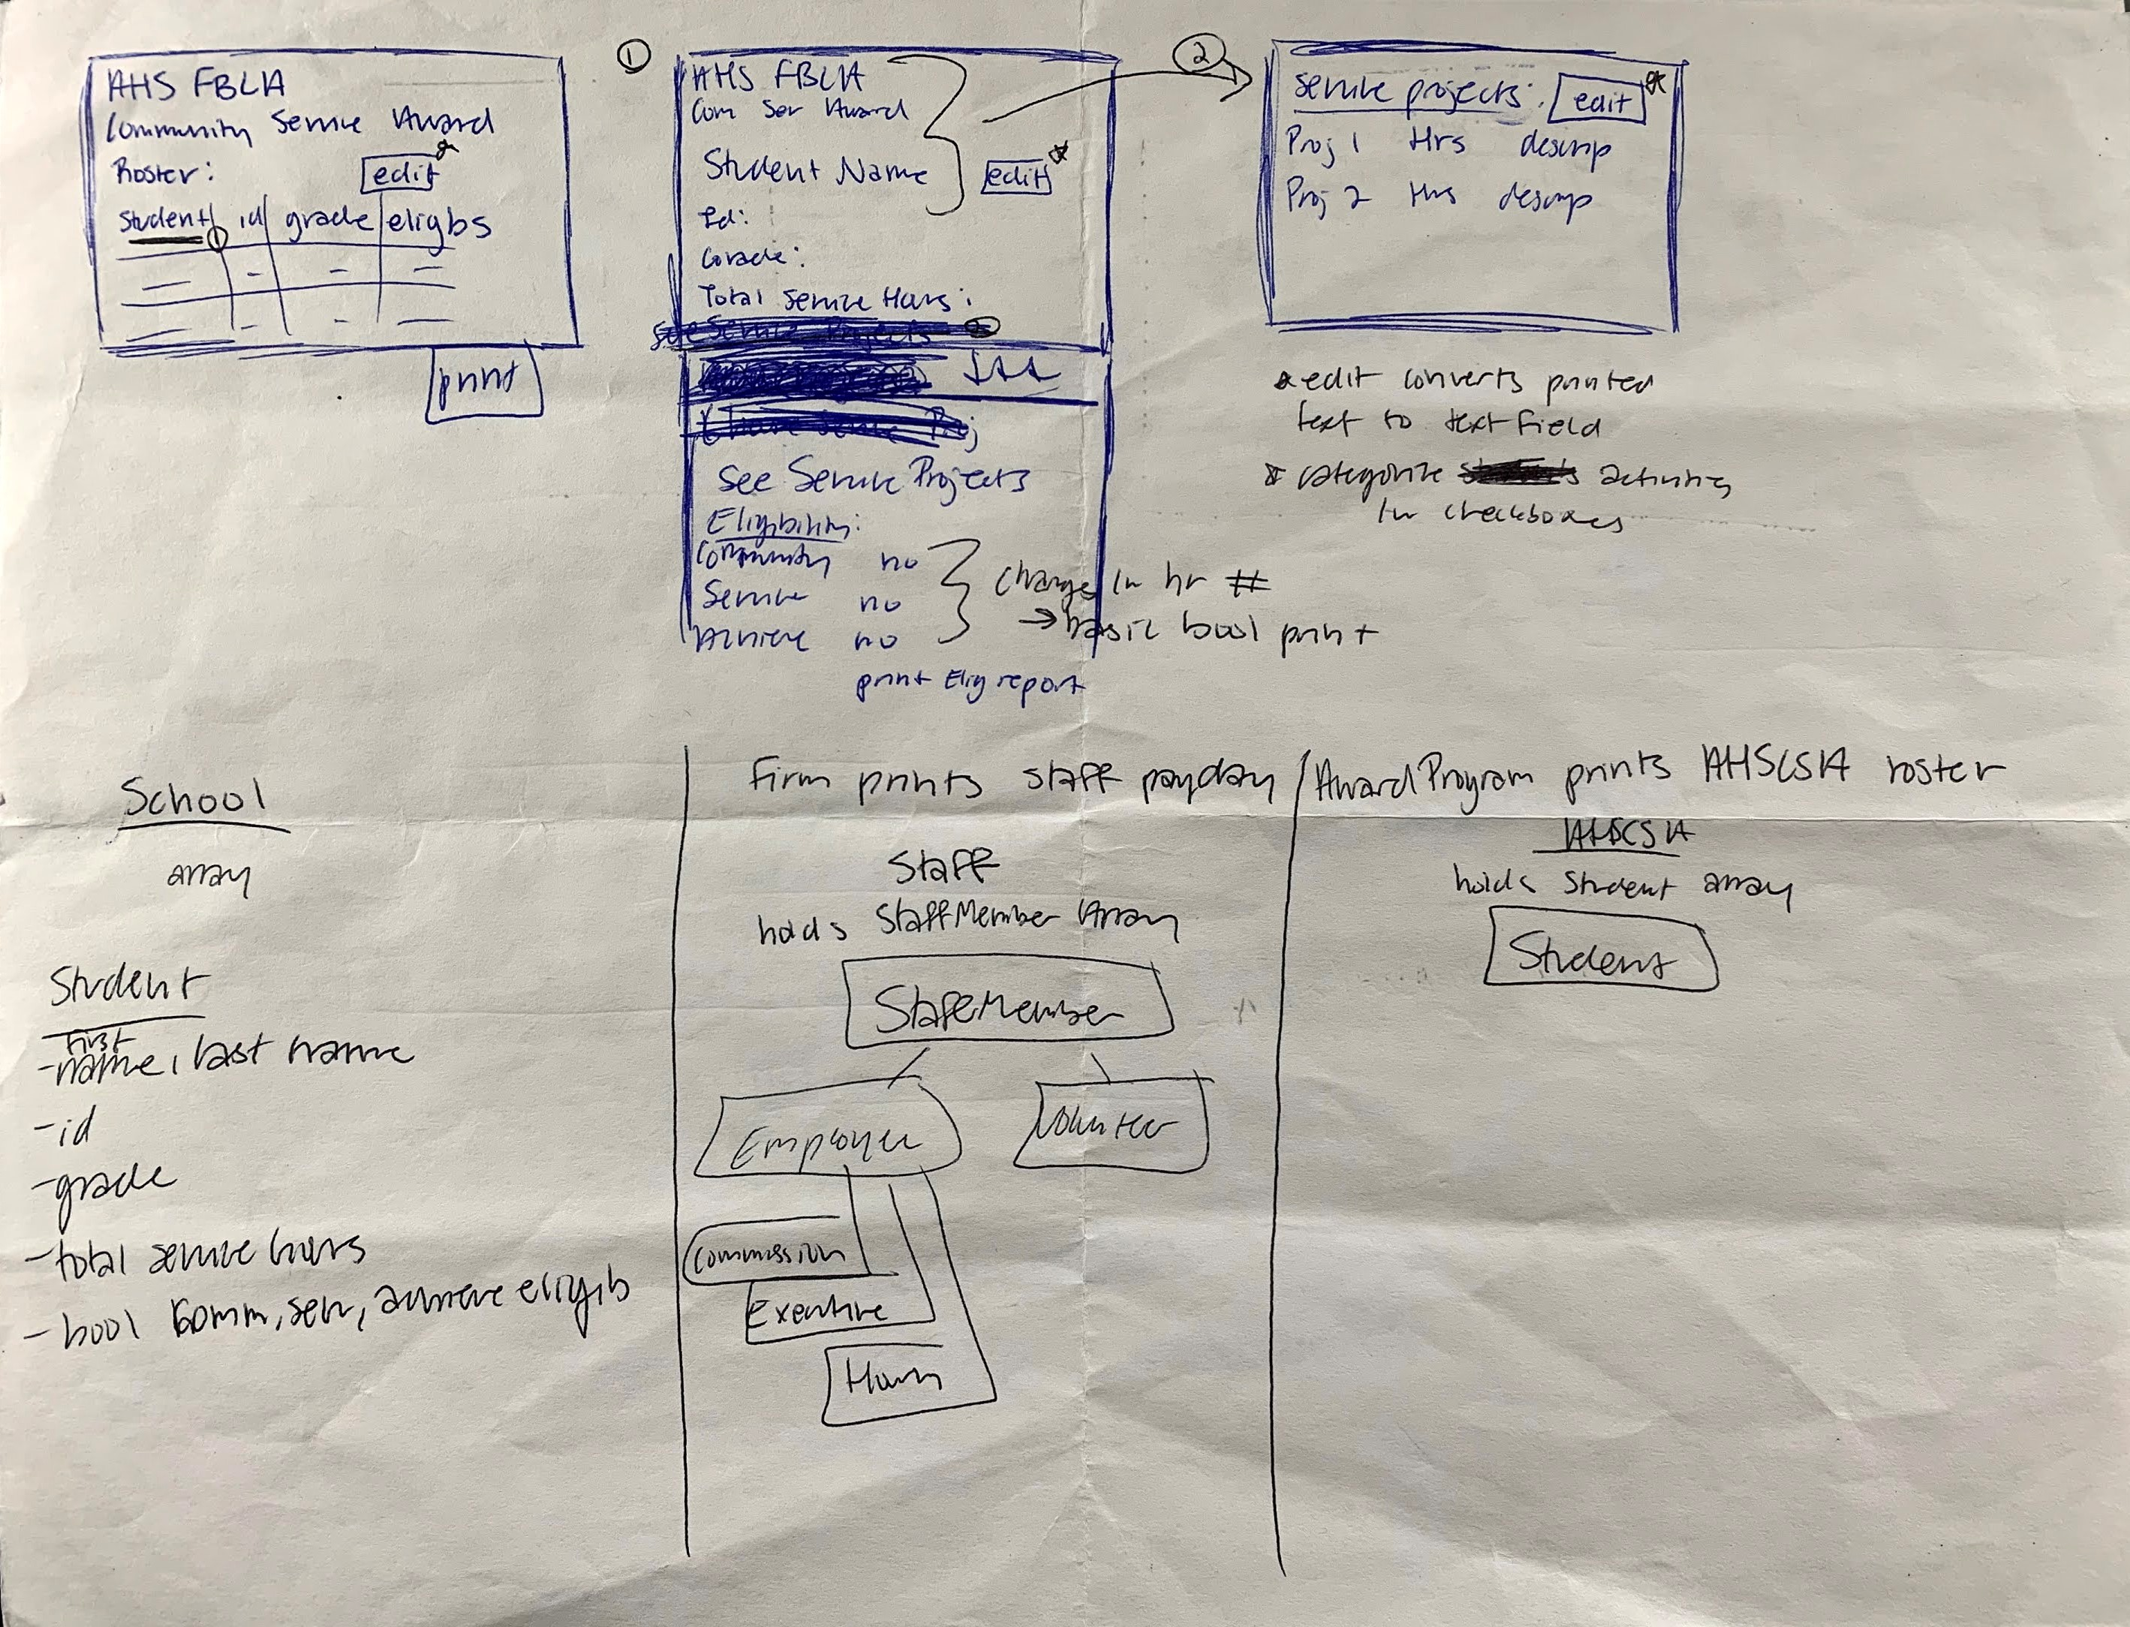
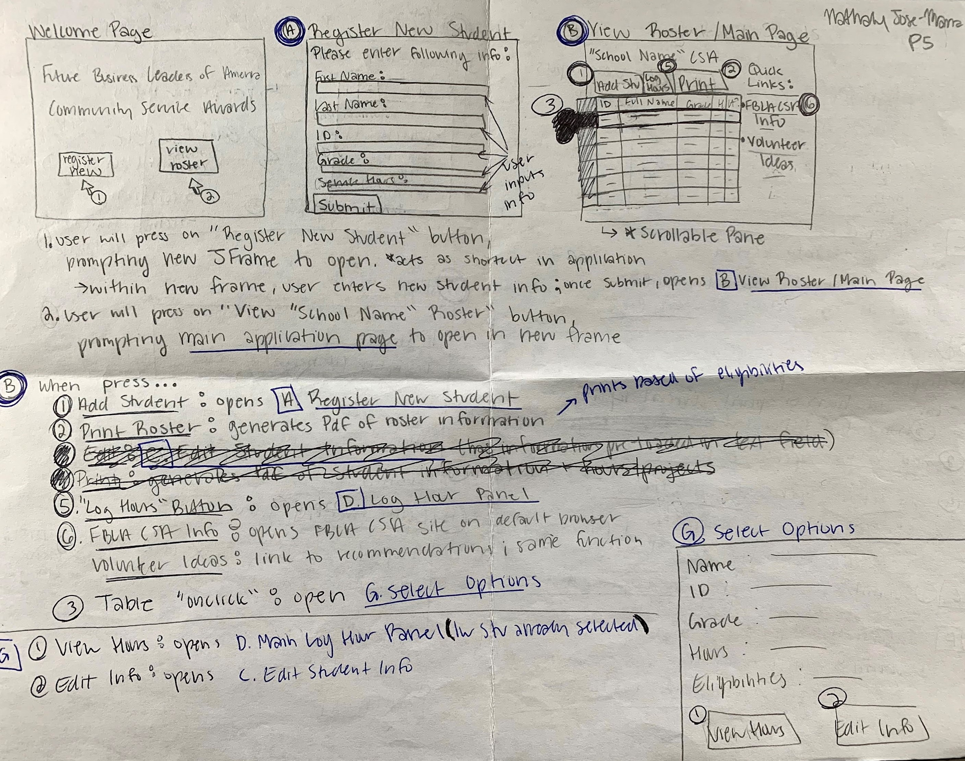
Aesthetic Decisions
Notes:
Pass out storyboard – include outline

Slide 5
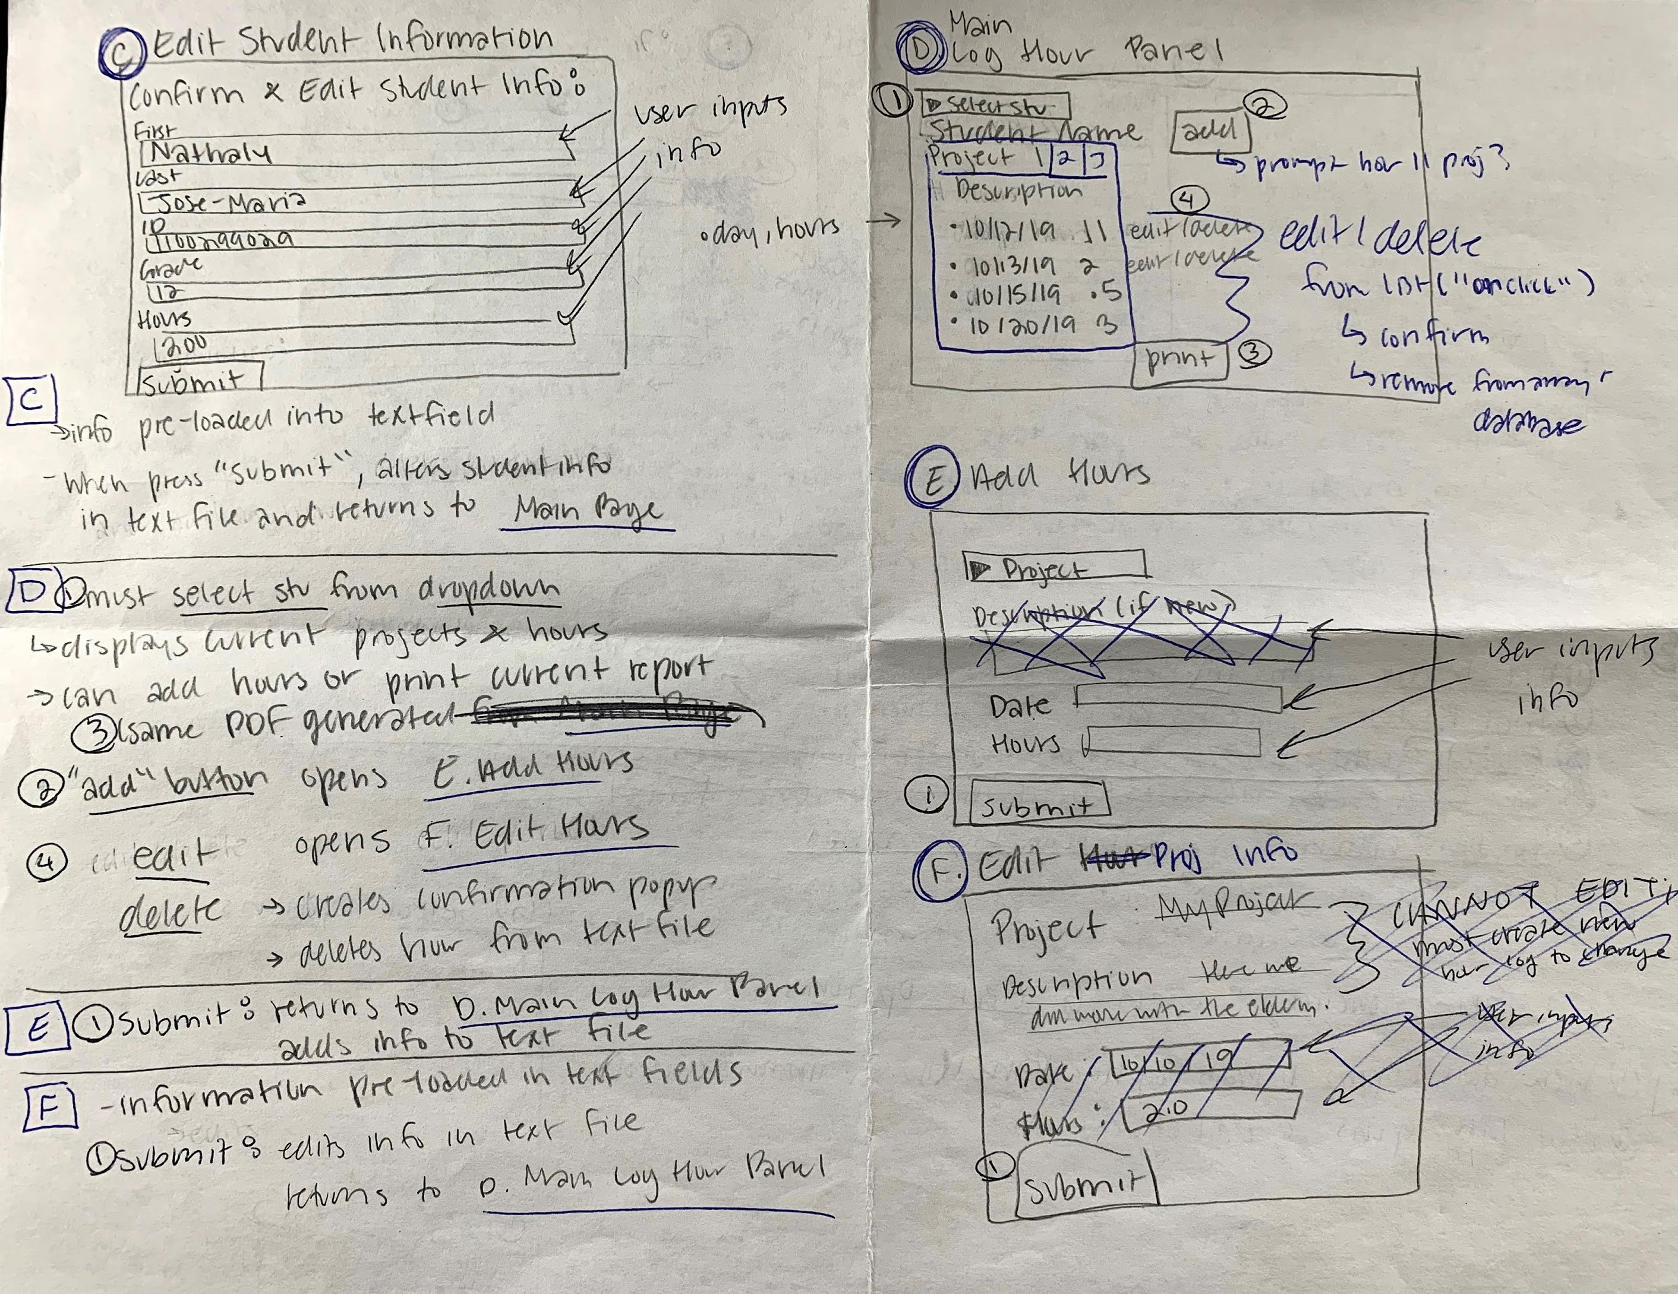
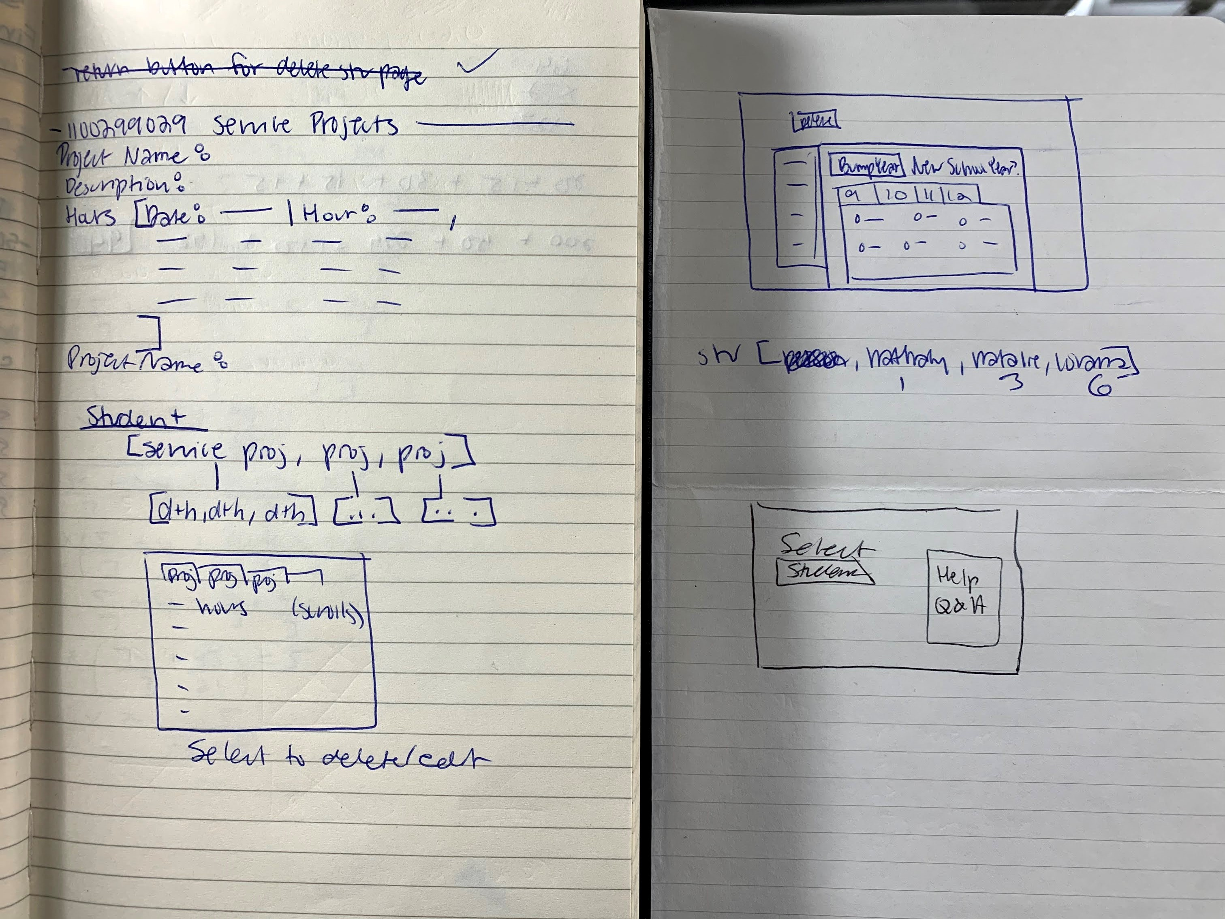
Aesthetic Decisions
Notes:
Changes:
Decided on separating student roster and individual student service information into separate pages because too much information in a single spot
Didn’t do links because of problems with Jpanel/layering panels
Moved all prints to the bottom of the page
Was going to add prints of individual student information/service hours but was outside of the guidelines and didn’t work with timeframe
Also request for prints was kind of confusing so solely focused on printing reports and less on weekly/monthly aspect since also not clear if determined by time hour was put in or hours in a specific month? Would need to work out request with a client
Diff control types: buttons, text fields, radio buttons, check boxes, scroll bar, dropdown

Slide 6
Execution
What do we have?

Slide 7

My Program

Slide 8
Now What?
Where are we headed next?

Slide 9
Future Developments
Appearance Changes
Improved Efficiency
Convenient Storage and Access
Aesthetically improved “Welcome” screen
Better manipulation of JPanels
Cleaner FAQ
Removing redundant selection screens
Alternative “Local Save” feature
Distinguished “Advisor” and “Student” Logins

Slide 10
Thank You!

